Slide 1

E. G. S. PILLAY ENGINEERING (AUTONOMOUS) COLLEGE
NAGAPATTINAM - 611002
Department of MCA
First Review
2.03.2026
TITLE
Web-Based Travel and Transport Management System
Supervisor
Project by,
Name :G.Nithya sri
Reg no :2403820862222040
Faculty Name : S.Visalatchy
Designation : Assistant Professor

Slide 2
CONTENTS
Abstract
Introduction
Literature survey
Objectives
Existing System Limitations
Proposed System
System Architecture
References

Slide 3
ABSTRACT
A Travels Website is a full-stack web application designed to provide an efficient and user-friendly online platform for travel services. The main purpose of this system is to allow users to easily access travel information such as tour packages, cab services, pricing details, and contact information through a single website.
It also enables users to submit booking or enquiry requests online, reducing the need for manual communication.
The frontend of the website is developed with a responsive and attractive interface to ensure smooth navigation across different devices. The backend manages business logic, processes user requests, and securely stores booking and enquiry data in a database. An admin module helps in managing travel packages and customer details effectively. Overall, the Travels Website improves customer experience, simplifies travel management, and supports the digital growth of travel businesses.

Slide 4
INTRODUCTION
In today’s digital era, the travel industry is increasingly moving towards online platforms to provide better and faster services. A Travels Website is developed to offer travel services such as tour packages, cab services, and booking enquiries through an online system. This helps customers access travel information easily and conveniently.
Traditional travel booking involves manual processes and direct communication, which can be time-consuming. The Travels Website overcomes these issues by providing a user-friendly frontend and a secure backend for managing bookings and customer details. This system reduces manual work and improves efficiency in travel management.
.

Slide 5
LITERATURE SURVEY
Related Work-1:
Title: Web-Based Travel Agency Management System
Author: S. Sharma et al.
Findings: The research developed a travel agency website to manage tour packages and customer enquiries. It improved business visibility and allowed customers to access travel information anytime online.
Related Work-2:
Title: Design and Implementation of Online Transportation Management System
Author: M. Patel et al
Findings: The system used frontend and backend technologies to manage schedules and bookings efficiently. It improved operational efficiency and customer satisfaction.

Slide 6
OBJECTIVES
To design and develop a user-friendly Travels Website.
To provide travel services information such as tour packages and cab services online.
To enable users to send booking and enquiry requests through the website.
To reduce manual work involved in traditional travel booking systems.
To develop a responsive website that works on mobile, tablet, and desktop devices.
To manage customer and booking details securely using backend and database.

Slide 7
EXISITING SYSTEM LIMITATIONS
Travel services are managed manually through phone calls and direct visits.
Customers cannot view tour packages and pricing details online.
There is a higher chance of human errors in booking details.
Manual booking processes consume more time and effort.
Limited customer reach due to lack of online presence.

Slide 8
PROPOSED SYSTEM
The proposed system is an Travels Website that:
Develop a web-based Travels Website.
Provide online access to travel services and tour packages.
Offer 24/7 availability for accessing travel information.
Use a responsive frontend for better user experience.
It securely stores customer and booking data using backend and database technologies.

Slide 9
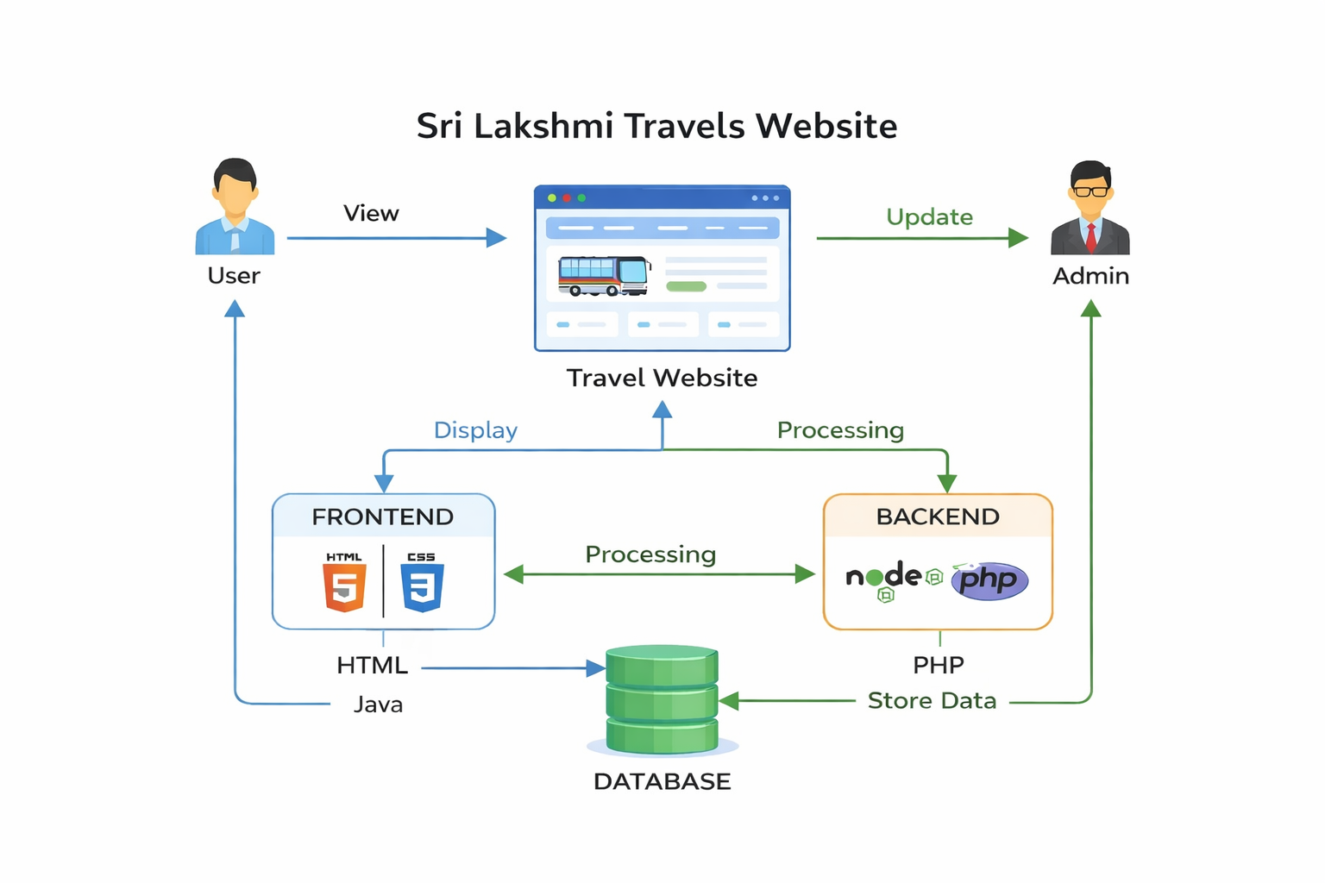
SYSTEM ARCHITECTURE

Slide 10
REFERENCES
In IEEE format
[1] S. Sharma and M. Gupta, “Web-Based Travel Agency Management System,” International Journal of Computer Science and Information Technology, 2018..
[2] M. Patel, K. Shah, and R. Desai, “Design and Implementation of Online Transportation Management System,” International Journal of Engineering and Technology, vol. 7, no. 3, pp. 112–116, 2019.

Slide 11
LIST OF MODULES
MODULE 1 : USER ACCESS & SECURITY MANAGEMENT
MODULE 2 : DRIVER OPERATIONS & CONTROL SYSTEM
MODULE 3 : SMART TOUR PACKAGE HANDLING SYSTEM
MODULE 4 : ADMIN CONTROL & SYSTEM MONITORING HUB

Slide 12
MODULE 1
USER ACCESS & SECURITY MANAGEMENT
Login Page This page allows registered users to log into the system using their credentials. It ensures secure authentication and prevents unauthorized access to the platform.
Registration Page New users can create an account by entering details such as name, email, and password. The system validates and stores the data securely.
Profile Management Page Users can update personal details, change passwords, and manage preferences to customize their experience.
Booking History Page This page shows all past and present bookings, helping users track their travel records easily.

Slide 13
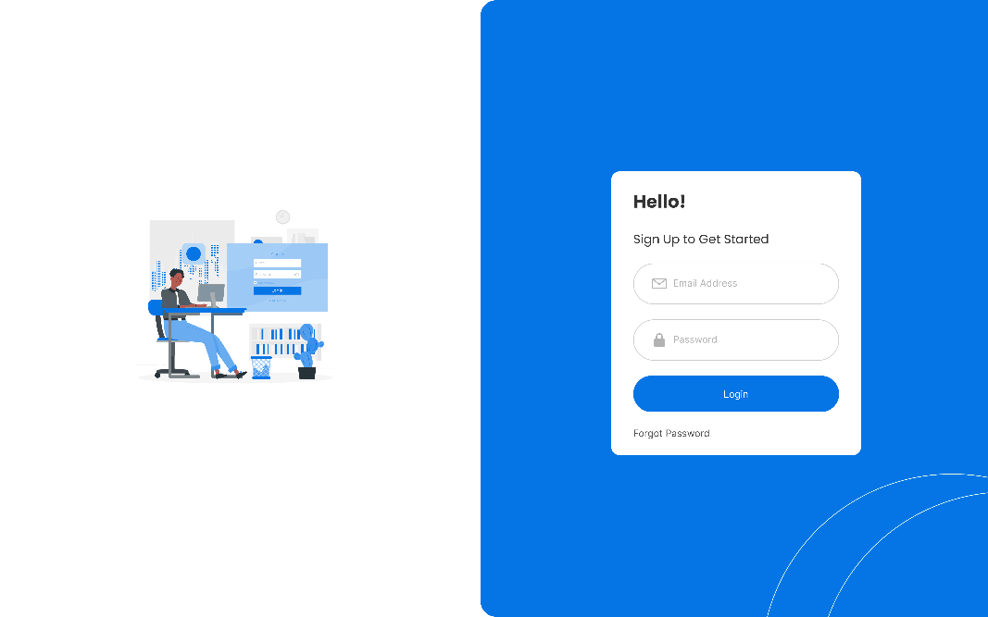
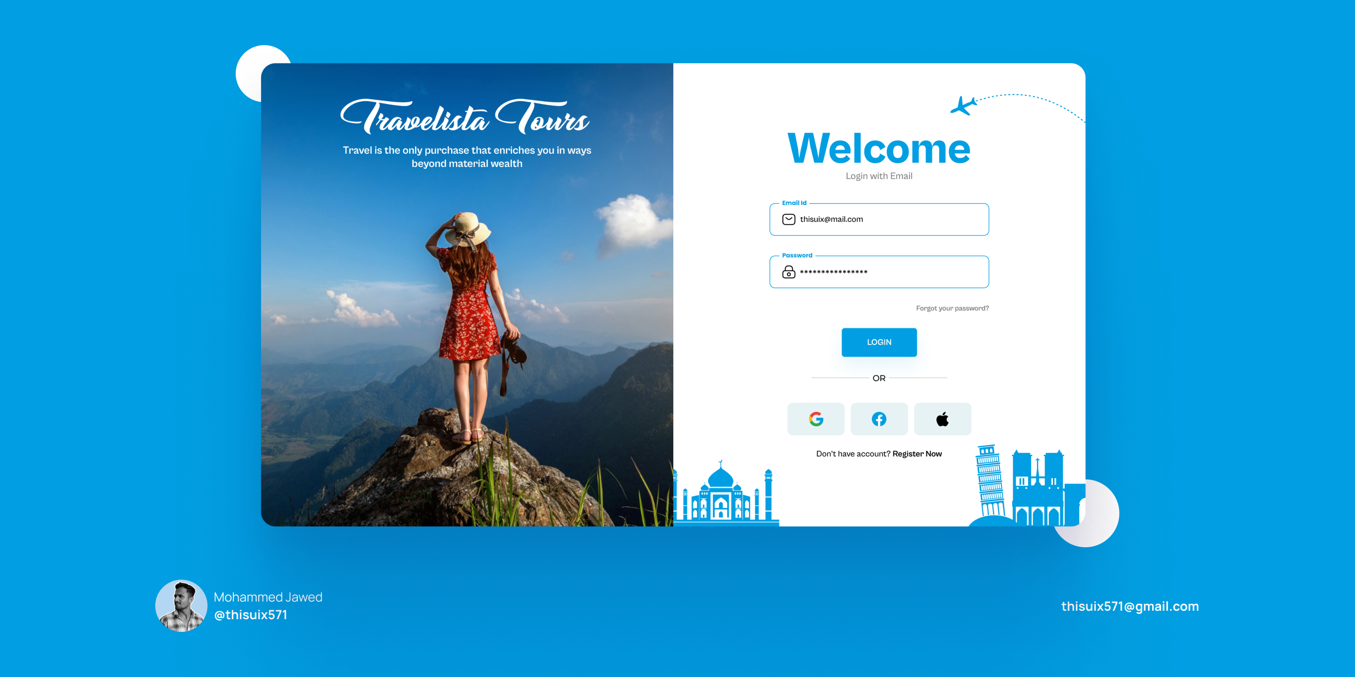
MODULE 1

Slide 14
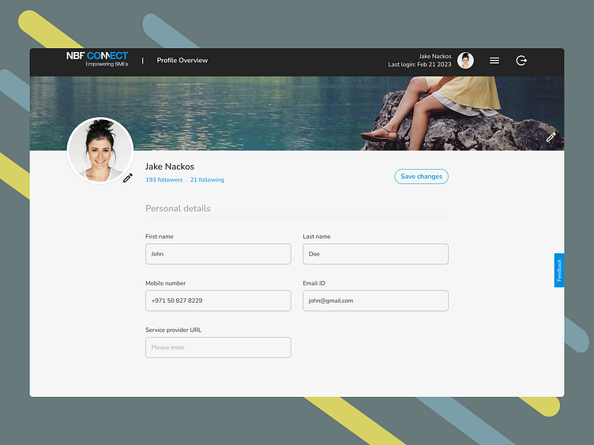
Profile page

Slide 15
DRIVER OPERATIONS & CONTROL SYSTEM
MODULE 2
Driver Listing Page Displays all available drivers along with their vehicle type, ratings, and basic information for easy selection
Driver Profile Page Shows complete details of drivers including experience, reviews, and service history to help users choose the best option.
Driver Availability Page Indicates whether drivers are online or offline, allowing users to book only available drivers.
Driver Booking Page Users can select a driver and confirm their ride based on their travel requirements.
Trip Details Page Displays complete trip information such as route, timing, and driver details.

Slide 16
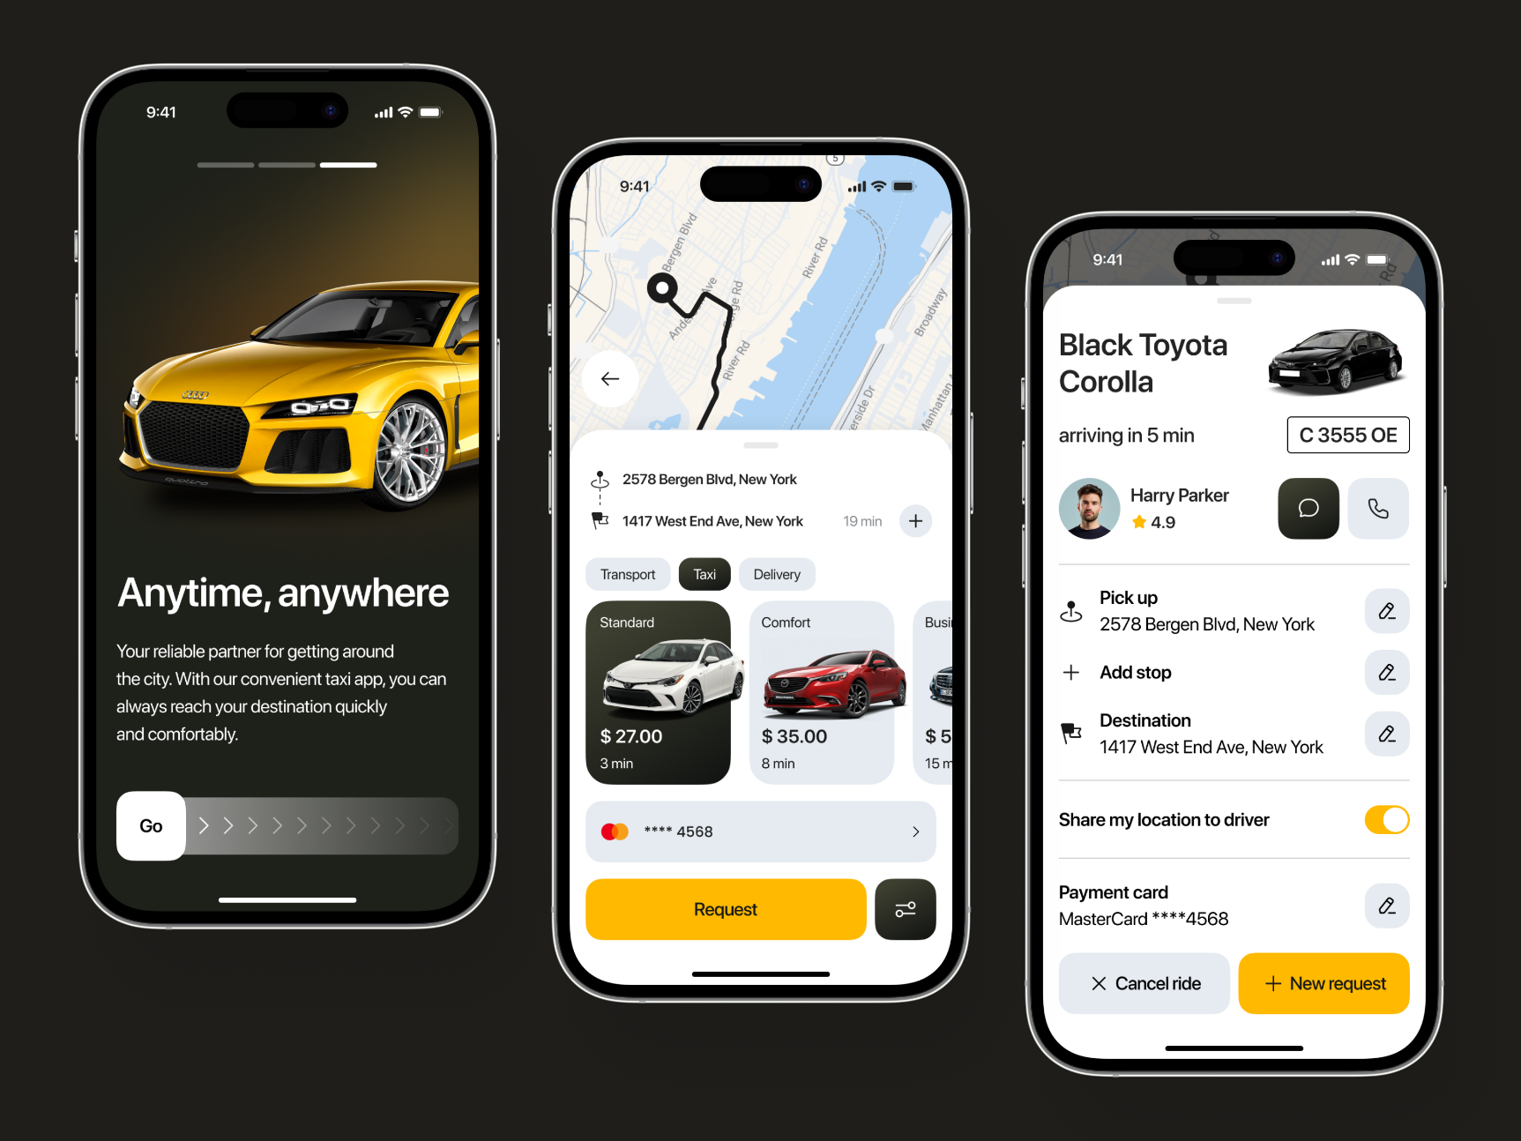
MODULE 2

Slide 17
MODULE 3
SMART TOUR PACKAGE HANDLING SYSTEM
Package Listing Page Displays all available travel packages with destination, price, and duration details.
Package Details Page Provides complete itinerary including accommodation, transportation, and sightseeing details.
Destination Page Shows popular tourist destinations with images and basic travel information.
Package Booking Page Allows users to select travel dates and confirm their tour package booking.
Custom Package Page Enables users to request personalized travel plans based on their preferences.

Slide 18
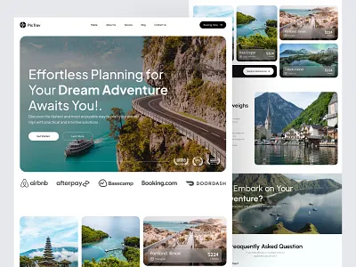
MODULE 3

Slide 19
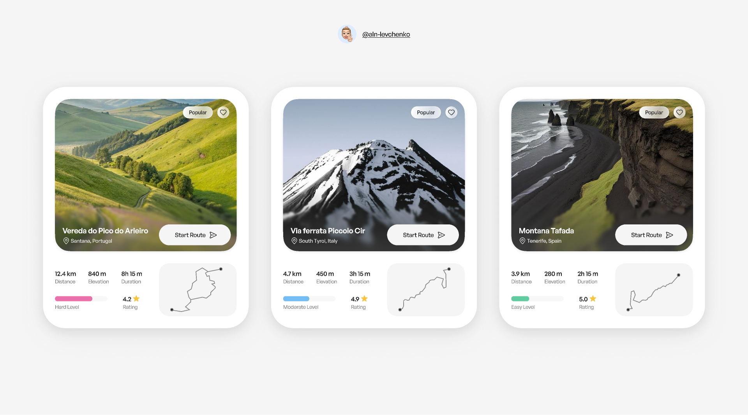
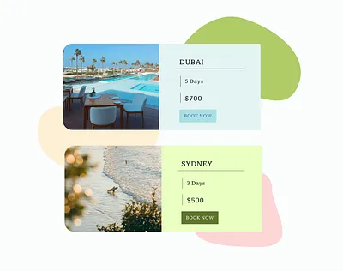

Slide 20
MODULE 4
ADMIN CONTROL & SYSTEM MONITORING HUB
Admin Dashboard Displays overall system data such as total users, bookings, and revenue in a summarized form.
User Management Page Allows admin to view, update, or delete user accounts and monitor user activities.
Driver Management Page Admin can verify driver details, manage availability, and maintain driver records.
Package Management Page Enables admin to add, update, or remove tour packages based on requirements.
Reports & Analytics Page Provides detailed insights into bookings, revenue, and system performance.

Slide 21
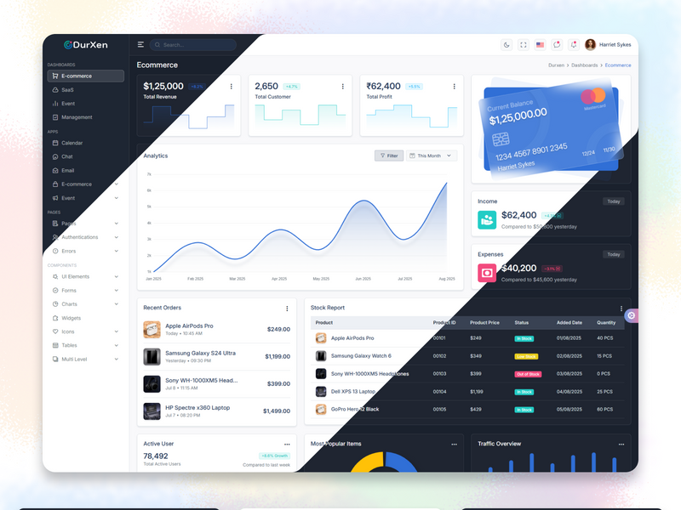

Slide 22
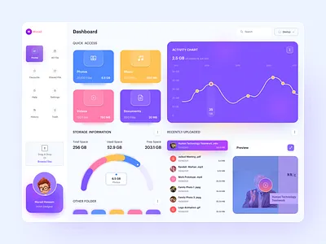

Slide 23
THANK YOU

